Slide 1
WB Carbon Monitor Cities
Residential
Work flow and exploratory analysis
CZ, 2022-07-27

Slide 2
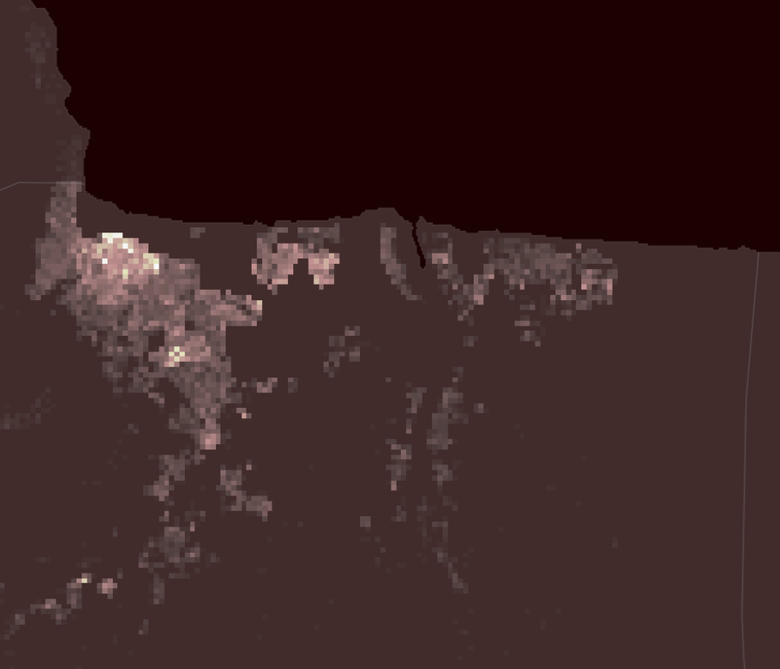
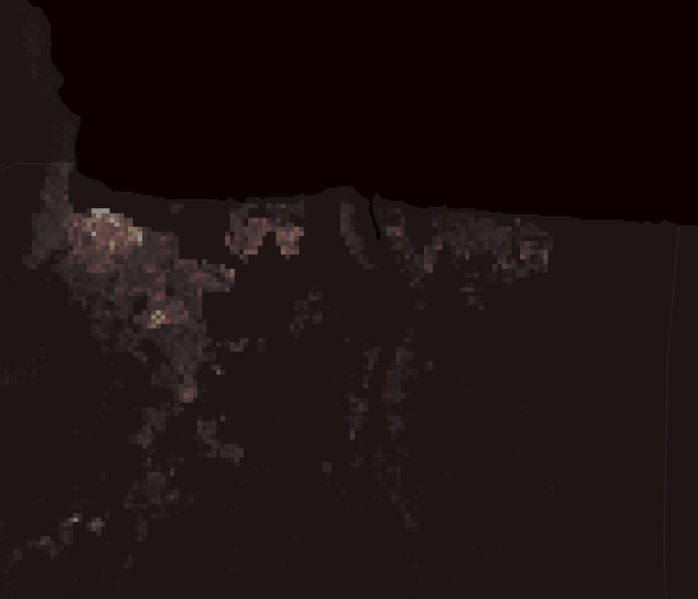
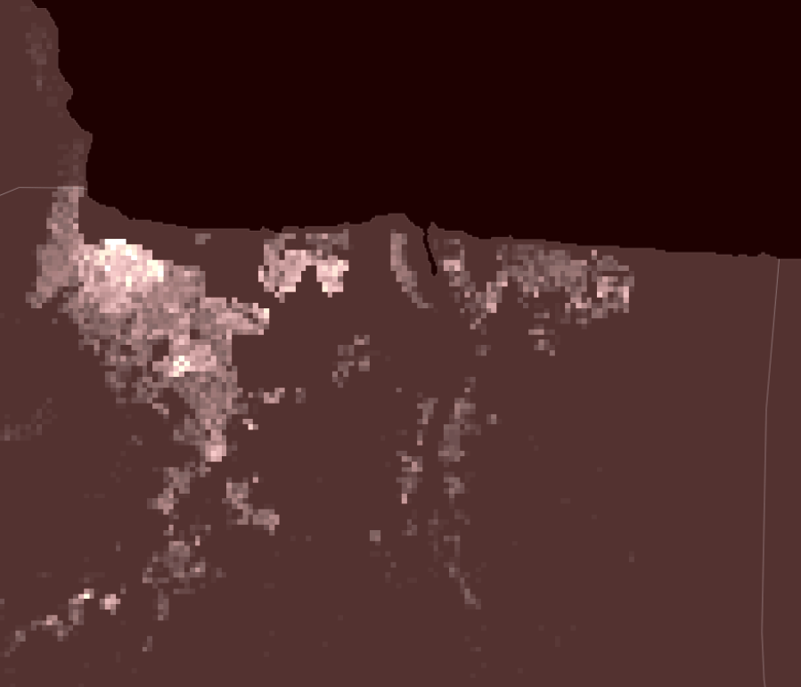
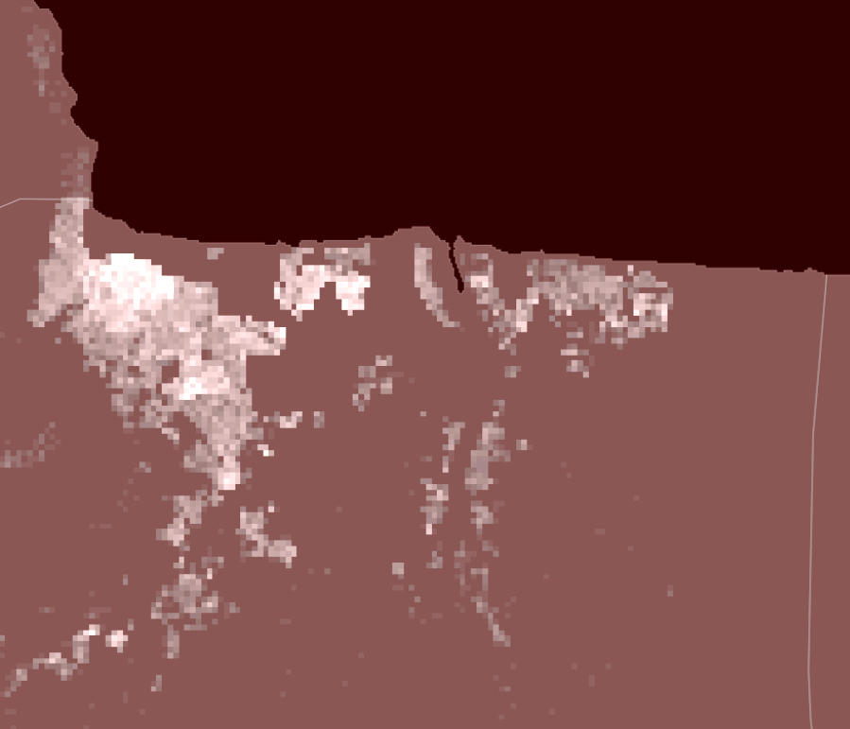
Near-real-time Grid CO2 Emission = f(Total Emission, Spatial Modifier, Temporal Modifier)
Spatial Modifier
The base emission for the grid
Total near-real-time
CO2 Emission
Near-real-time Grid CO2 Emission
f(building, household, population, land use type, heating/cooking source, …)
Temporal Modifier
The emission varied with time for the grid
Total regional emission from carbon monitor database
100*100 m
f(electricity, nightlight, surface temperature, air temperature, …)

Slide 3
Near-real-time Grid CO2 Emission in City’s Residential Area
f(Total Emission,
Spatial Modifier,
Temporal Modifier)
Spatial Modifier
Emission estimator
Economic indicator
Buildings
Population, Households
GDP, energy source,
Cooking/heating source, …
Area, Height, Type
ML model based on Open street map Buildings (OSMB) and other land use/cover datasets
Microsoft database (unlabeled)
Land use/cover
Total near-real-time CO2 emission
(from carbon monitor database)
Building Prediction
LCZ, human settlement layer, google landcover, …
Spatial res:
100*100 m or 500*500 m
Temporal res:
Daily or weekly
Output
Temporal Modifier
Energy consumption
Climate
Electricity,
VIIRS nightlights, …
Air temperature,
Land surface temperature, …

Slide 4
Datasets
Level | data | source
Country level | heating/cooking source | Census data or governmental statistical data
 | energy structure
 | GDP
 | Poverty
 | Other economic indicator
City/division level | Population
 | household number
 | household size
Polygon level | Building number | ML model output trained with MS building dataset, OSMB dataset, and other grid-based dataset, such as LCZ, Copernicus DEM, night light, …
 | Building area, type, level
Grid level | LCZ (100*100m) | https://zenodo.org/record/6364594#.YsgpS3ZBybg
 | Human settlement layer | https://ghsl.jrc.ec.europa.eu
 | VIIRS nightlights | https://eogdata.mines.edu/products/vnl/
 | Google land cover | https://blog.google/products/earth/dynamic-world-land-cover-data/
 | Copernicus DEM | https://spacedata.copernicus.eu/web/cscda/dataset-details?articleId=394198
 | Land surface temperature
 | Air temperature | ERA5 model
Note: the datasets are not limited in those are listed, and we will replace some of those datasets if we find some alternative dataset with higher quality.

Slide 5
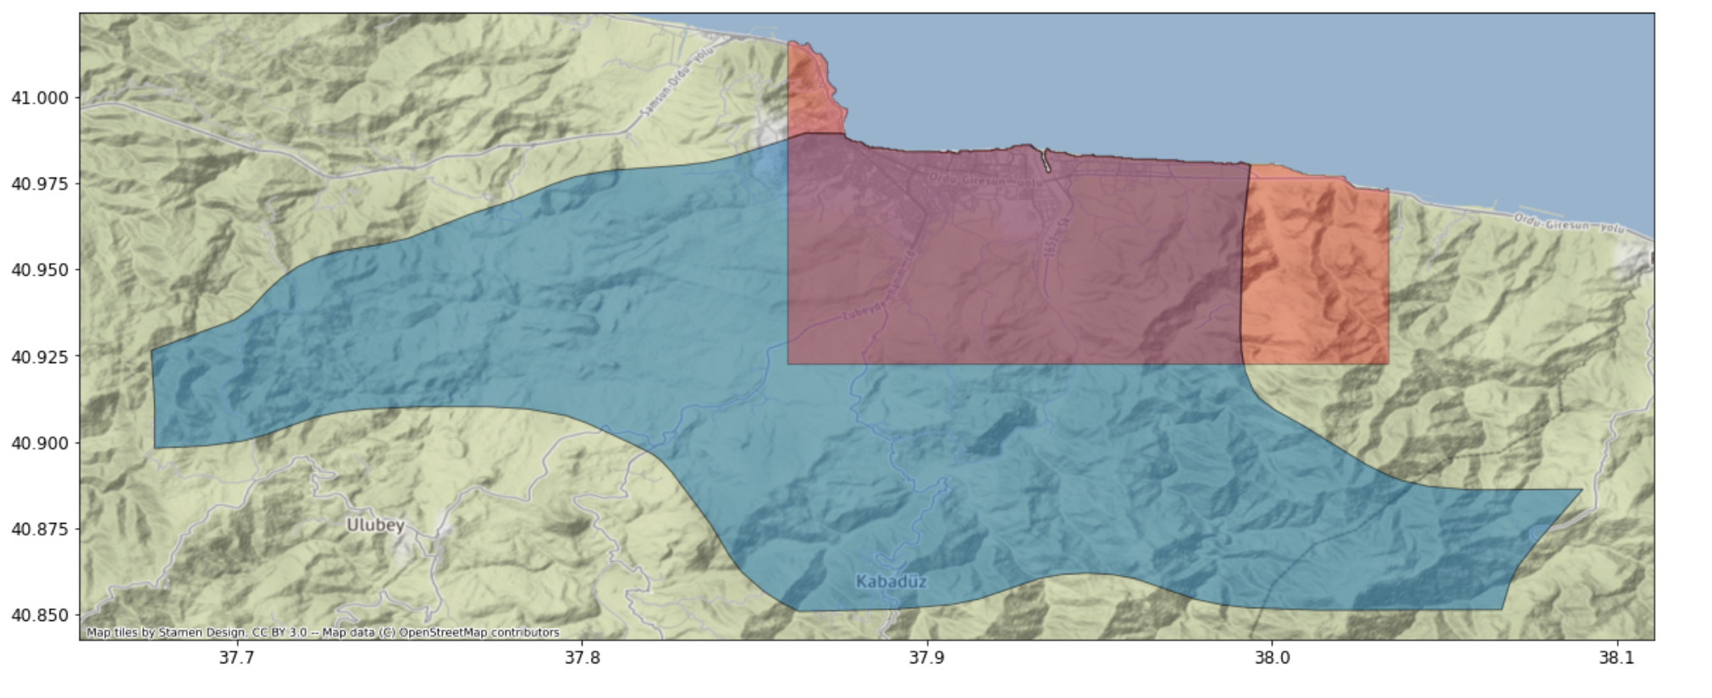
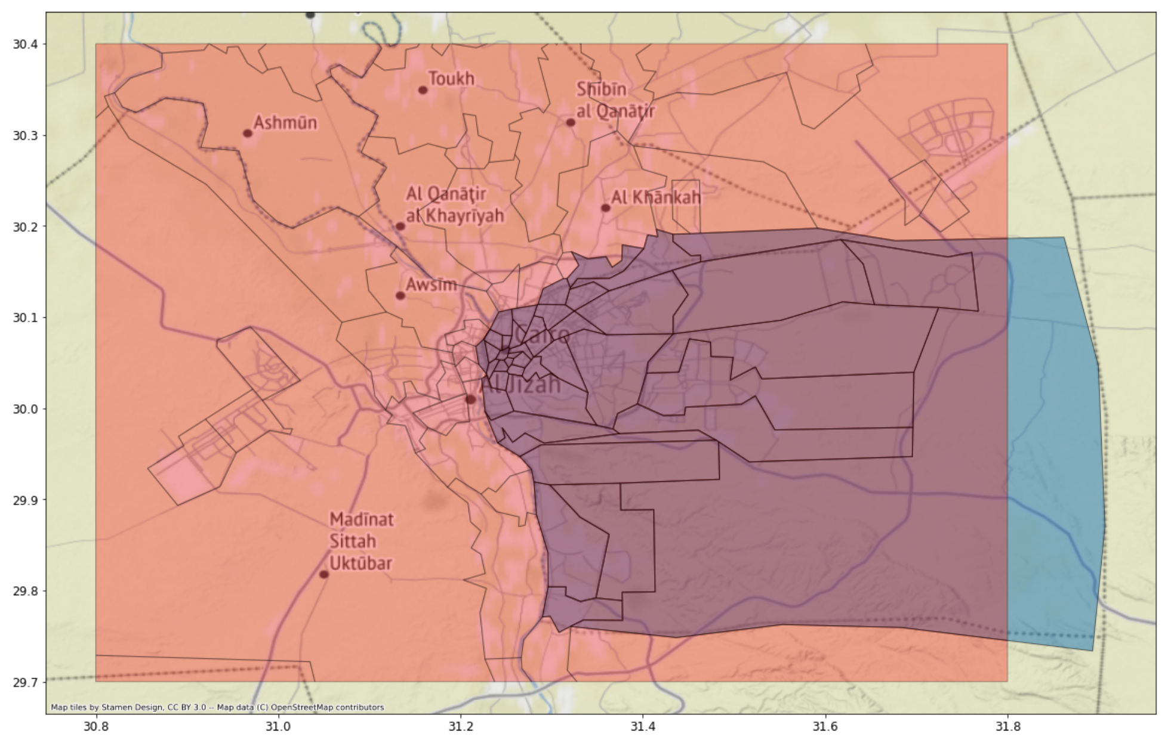
Region defines
Regions need to be defined with boxes
Administrative divisions include large non-urban areas (not of our interests)
Continuous urban areas are divide into parts by administrative division
Uncertainties
We assume the selected regions has the same administrative region data, such as population, household number, …

Slide 6
How we select the region
The most populated region (urban area) for the proposed cities will be included.
The closely adjacent populated regions will also be included until the we see a clear break of the urban area, or the region become too large.
We adjust the region based on the MS buildings and LCZ maps (world urban database, https://www.wudapt.org/lcz-maps/)
Most of the dense building areas (both MS buildings and LCZ categories) are included in our regions

Slide 7
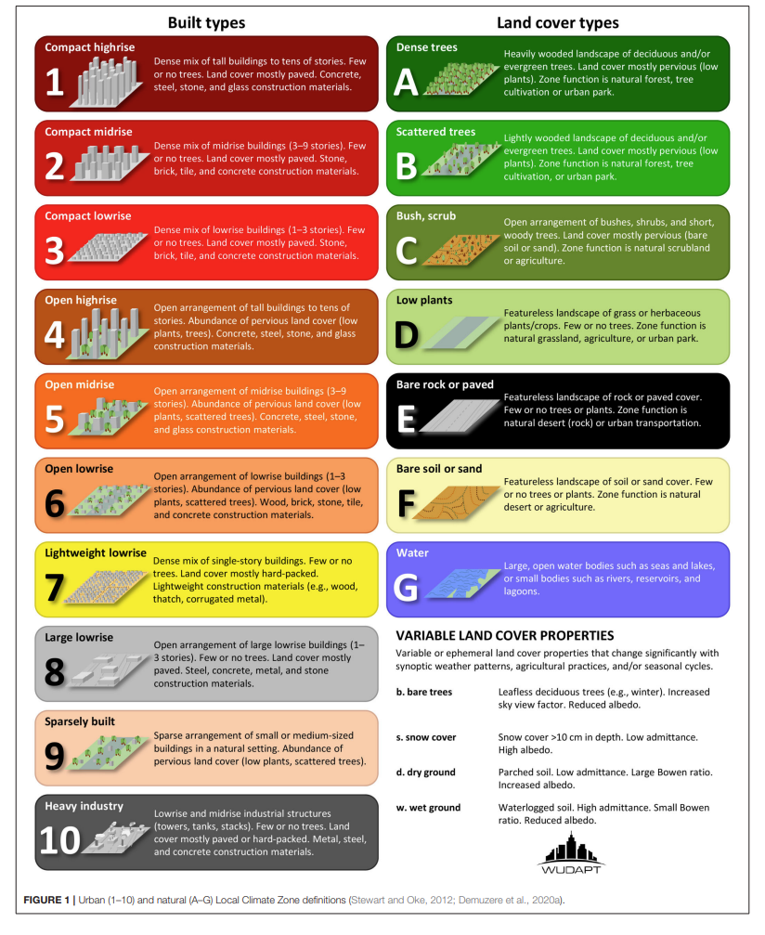

LCZ class and color scheme
Water
Sand
Rock
Low plants
Bush
Scatter trees
Dense trees
Industrial
Buildings in nature land cover
Large 1-3 stories
Dense 1 story
1-3 stories
3-9 stories
Over 10 stories
Dense 1-3 stories
Dense 3-9 stories
Dense over 10 stories

Slide 8
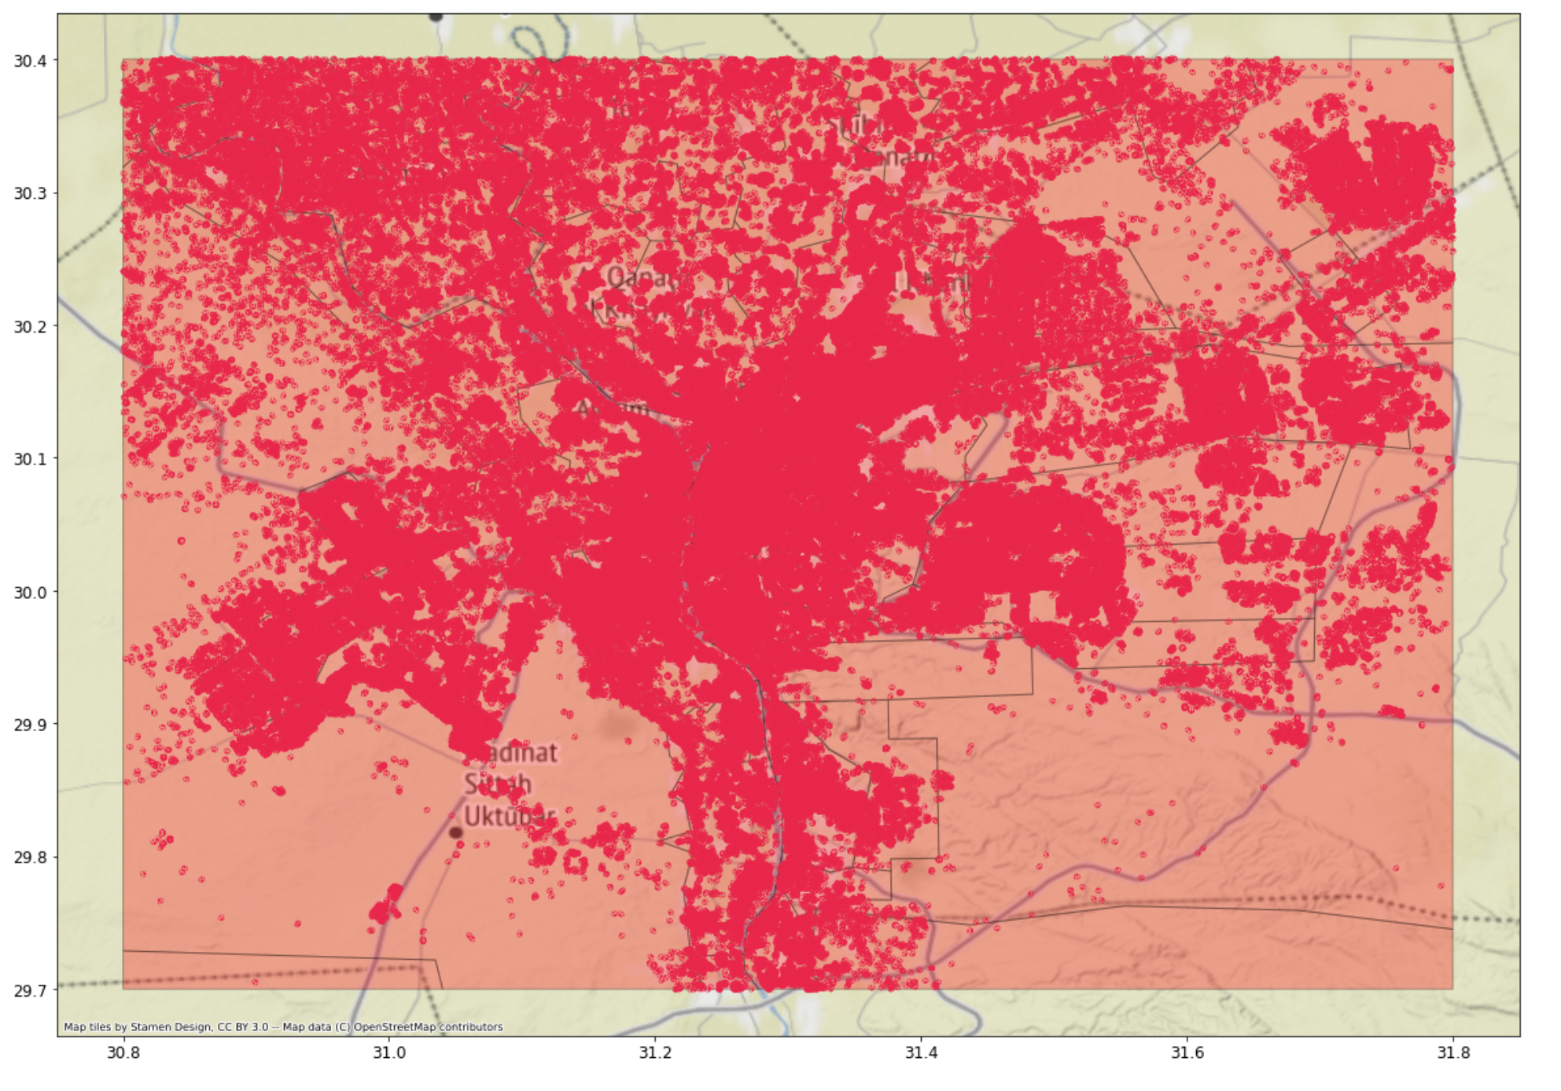
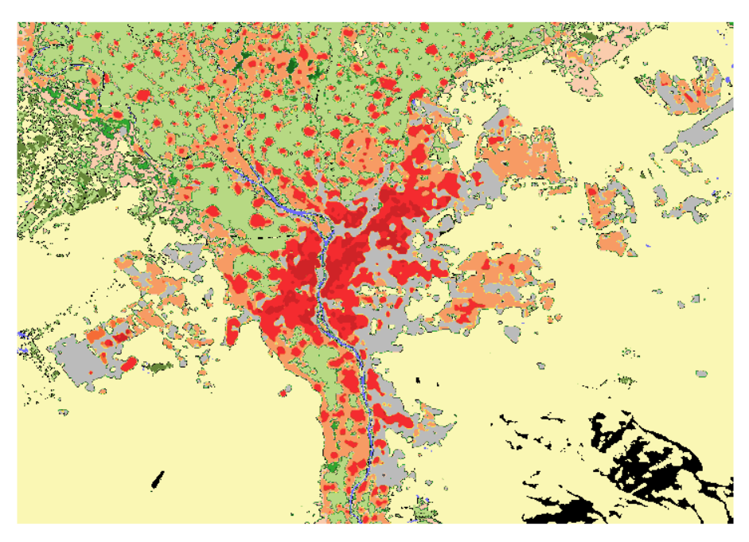
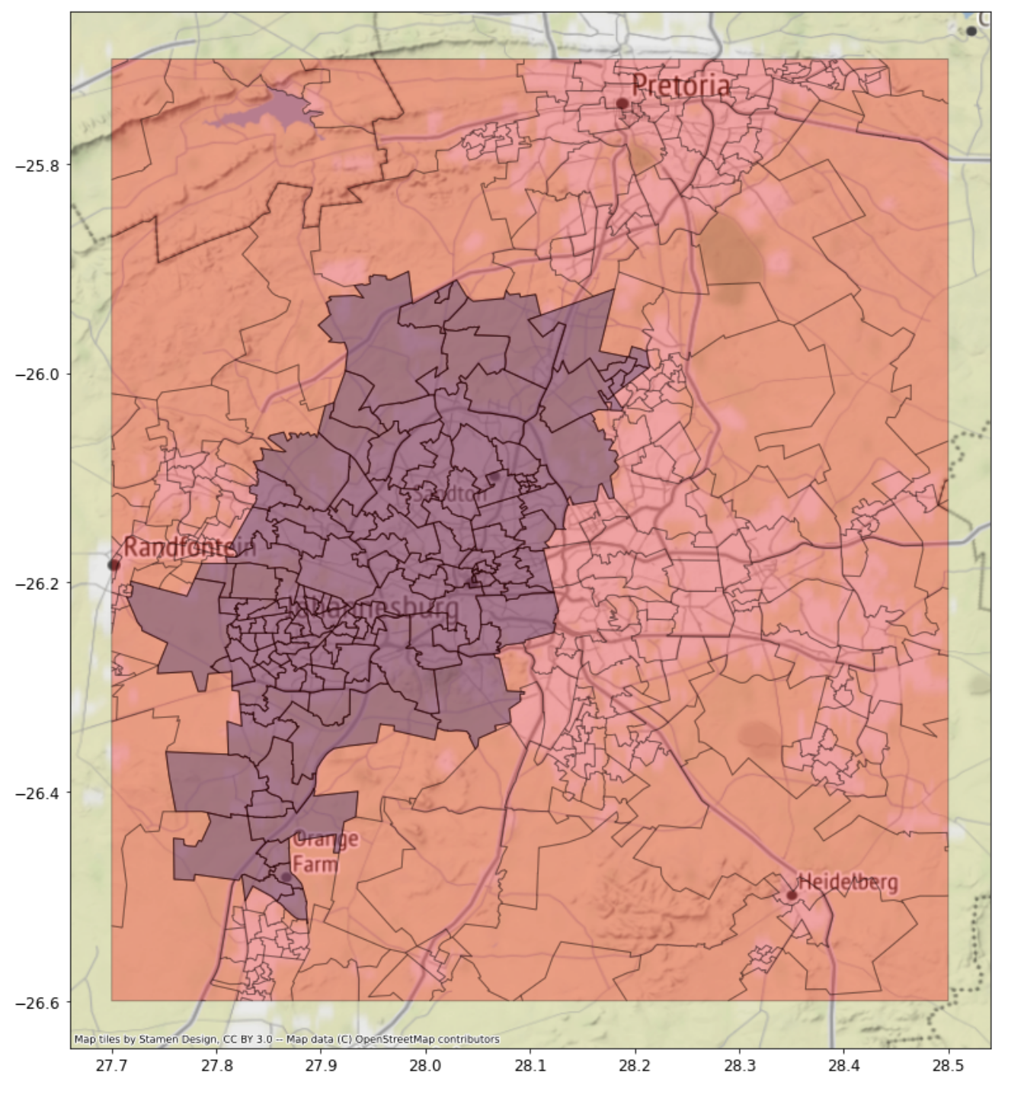
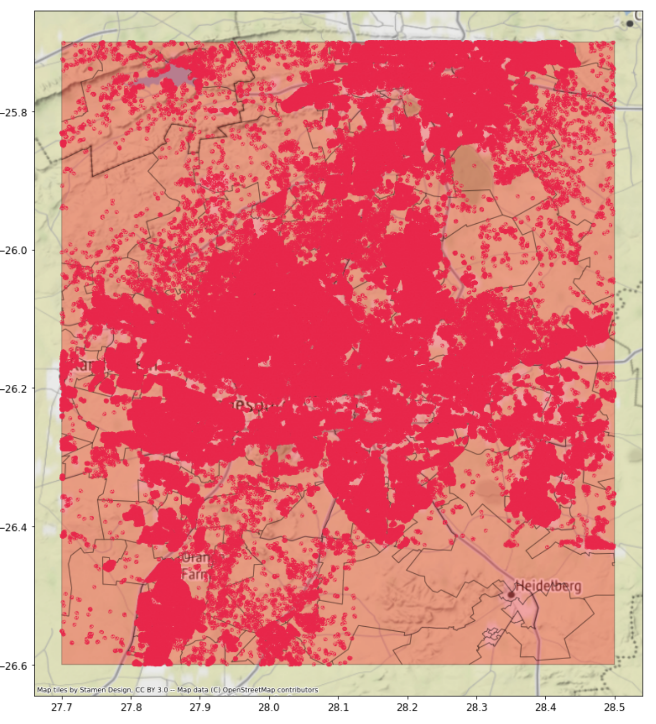
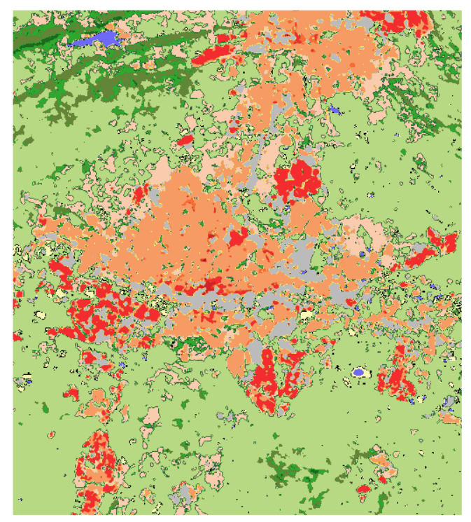
Cairo
Top left: (30.4, 30.8),
Bottom right:(29.7, 31.8)
Microsoft building
Johannesburg
Top left:(-25.7, 27.7),
Bottom right:( -26.6, 28.5)

Slide 9
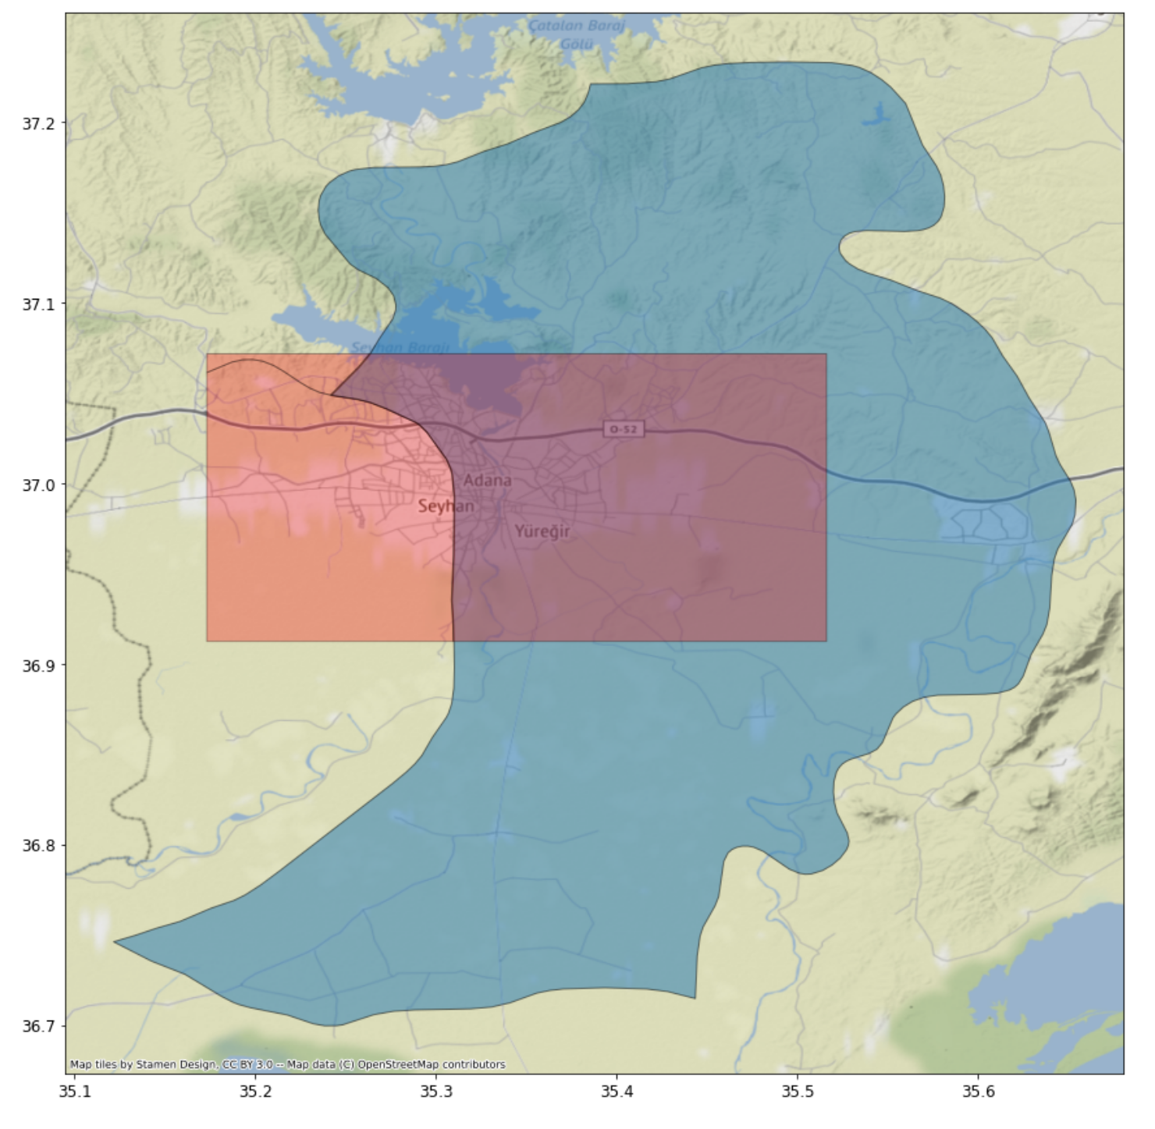
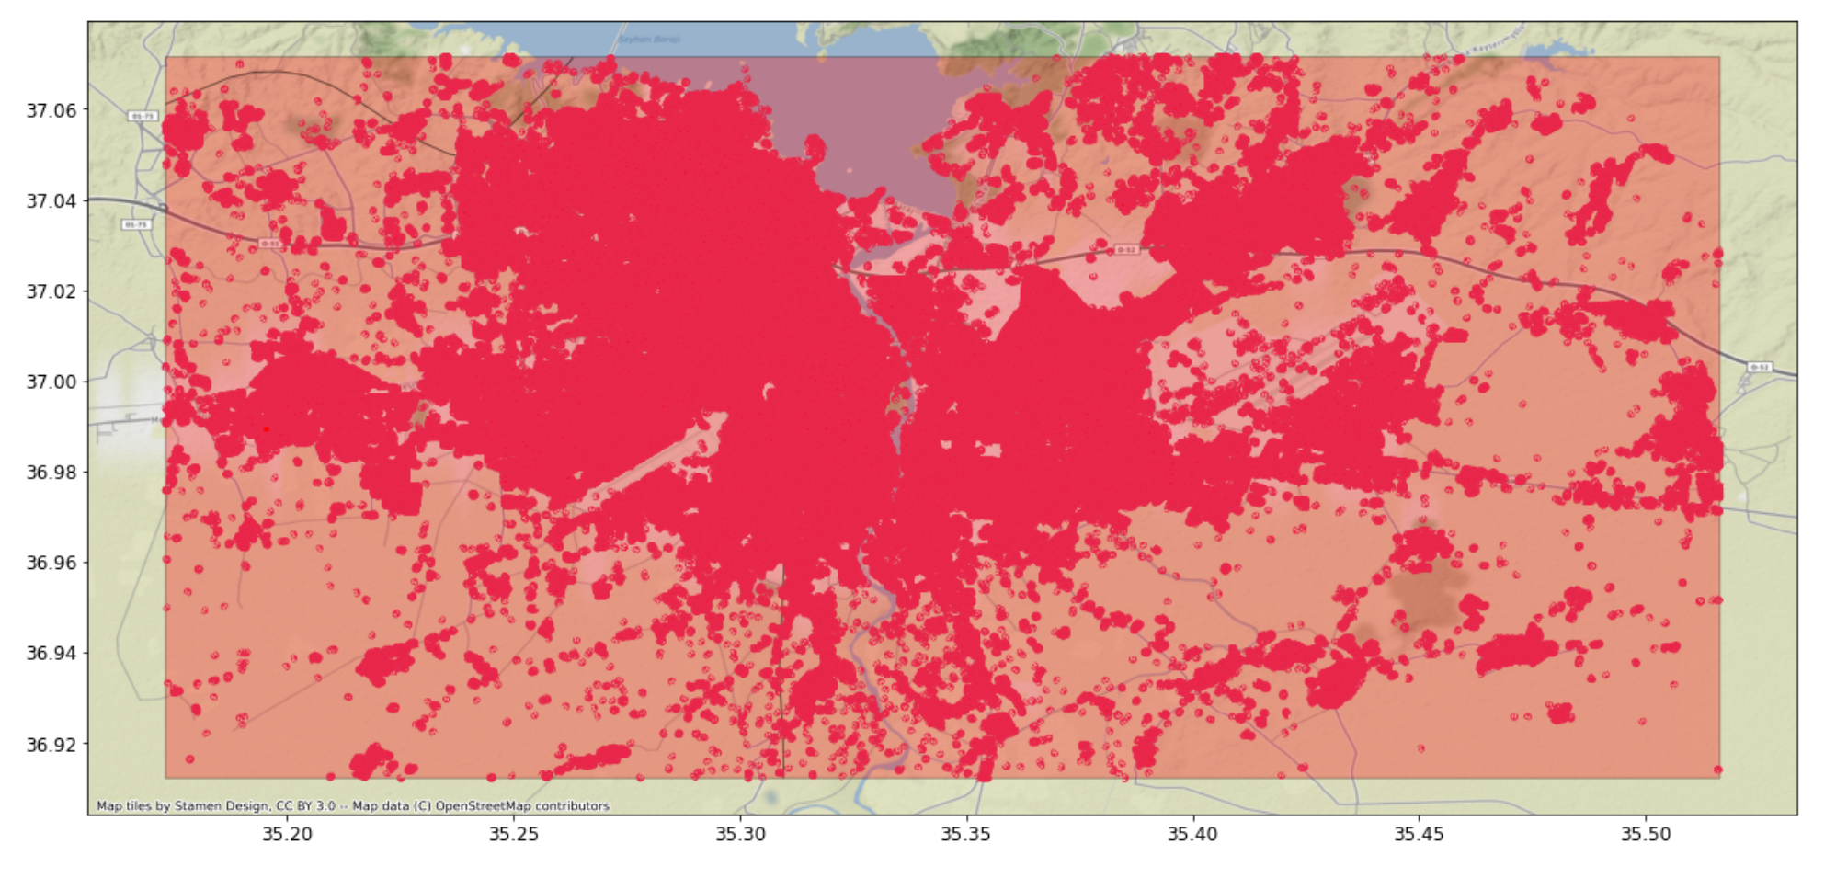
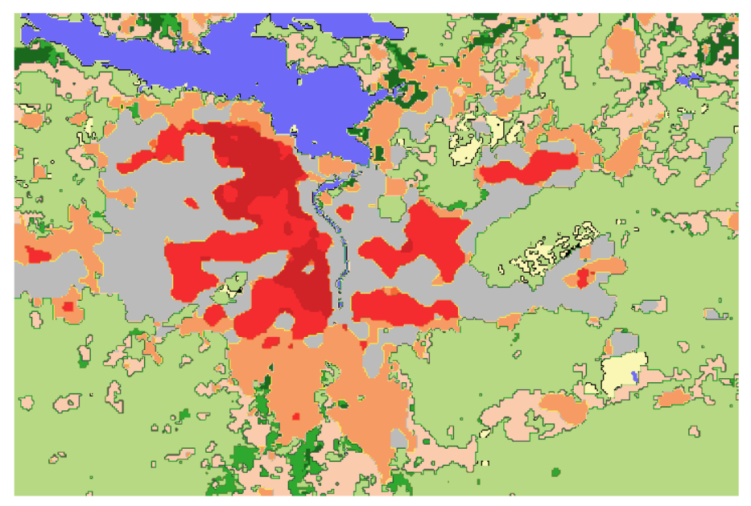
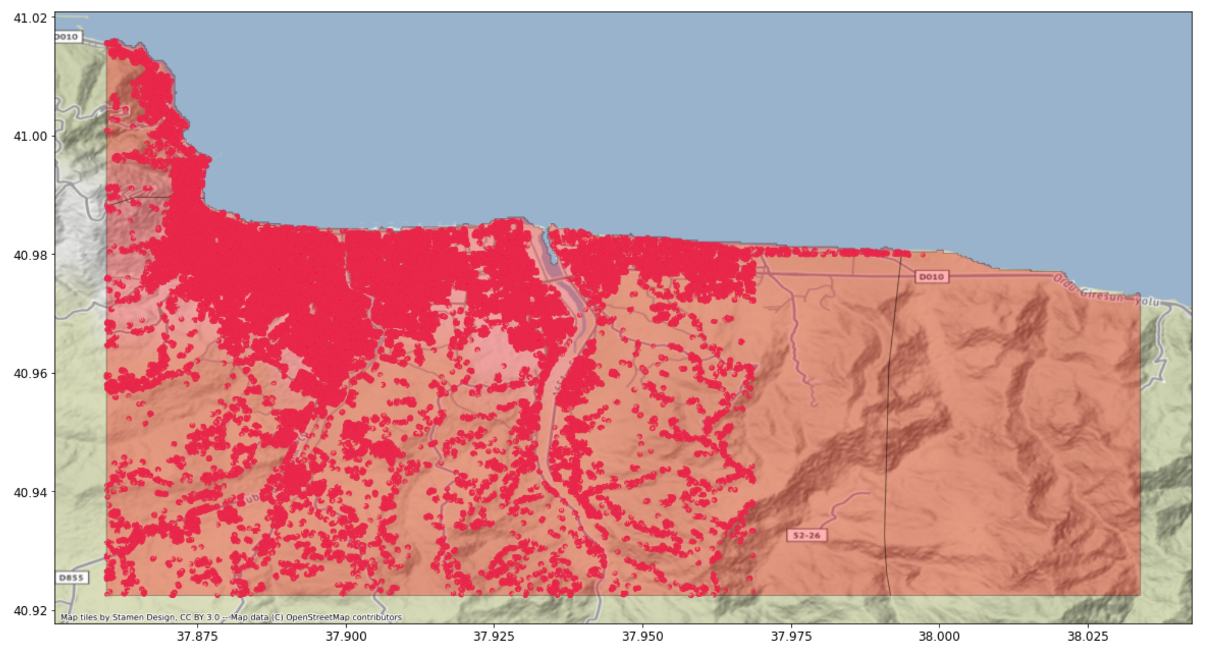
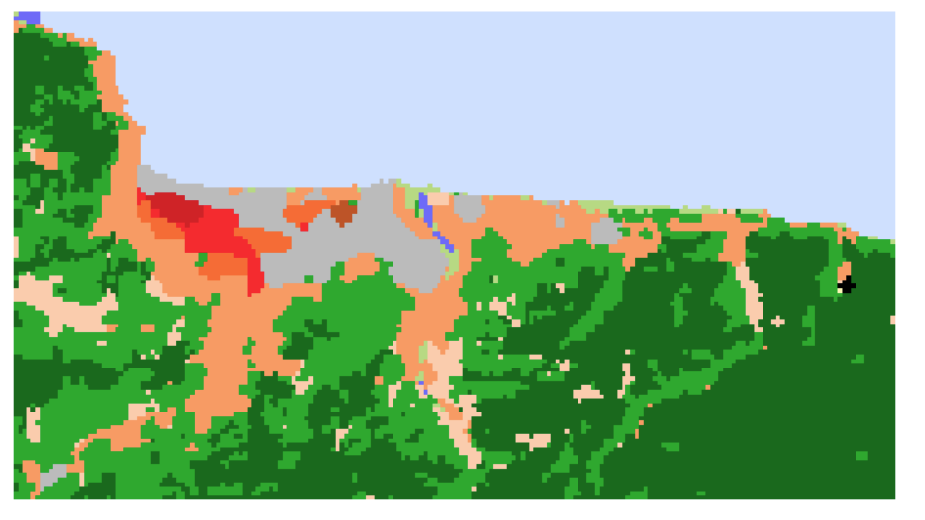
Adana
Top left:(37.1, 35.2),
Bottom right:(36.9, 35.5)
Ordu
Top left:(41.02, 37.85),
Bottom right:( 40.92, 38.03)

Slide 10
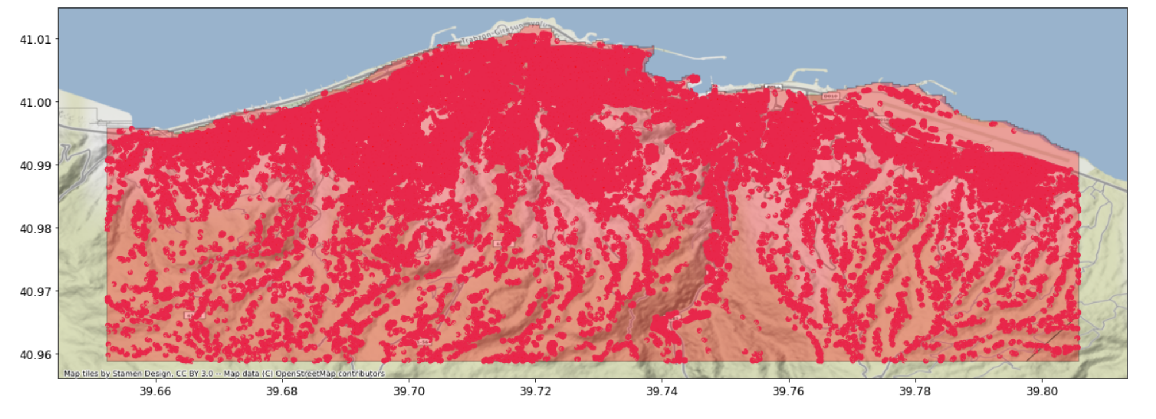
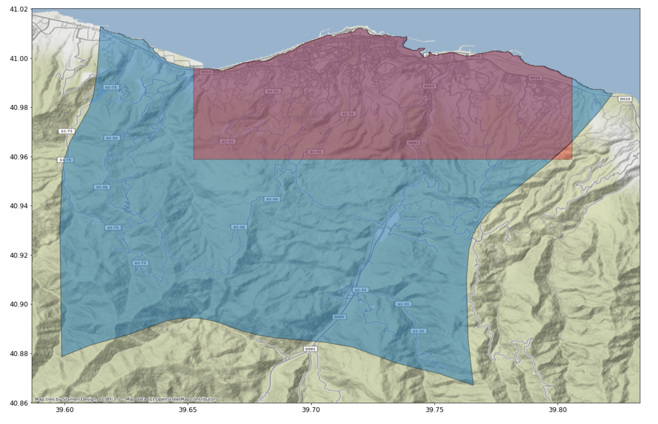
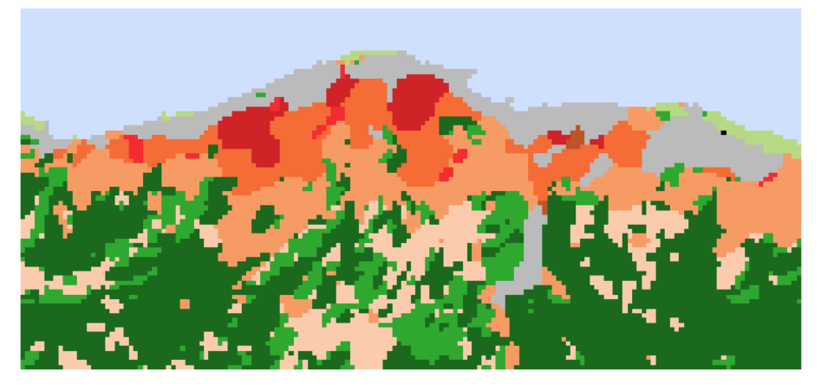
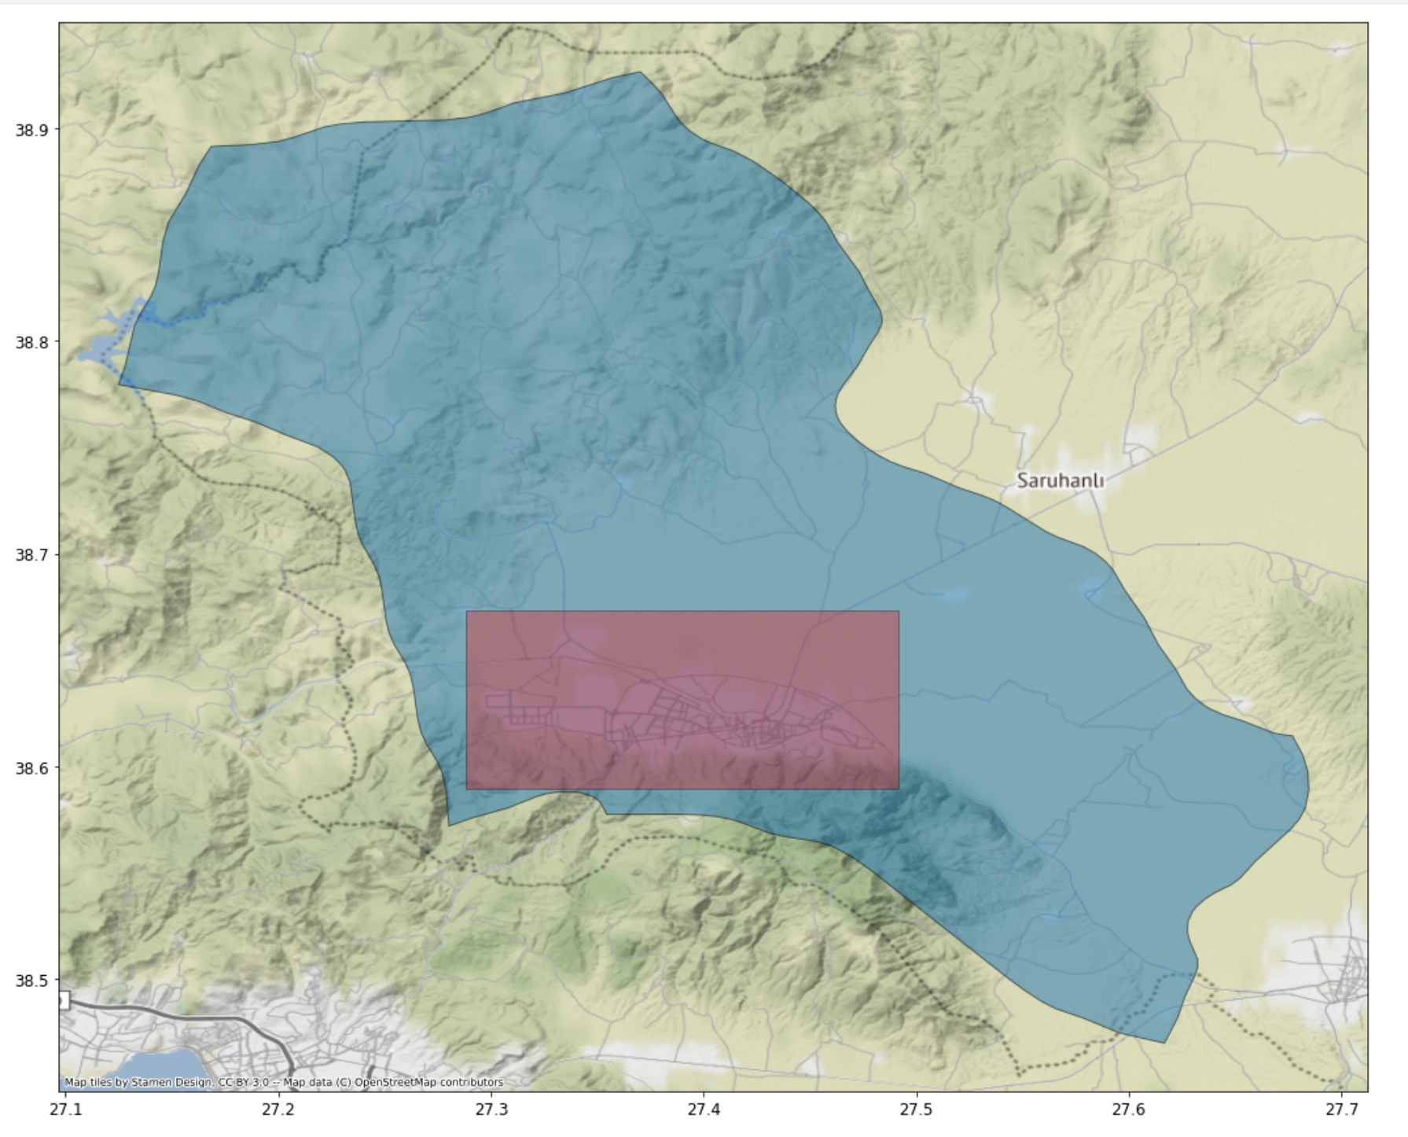
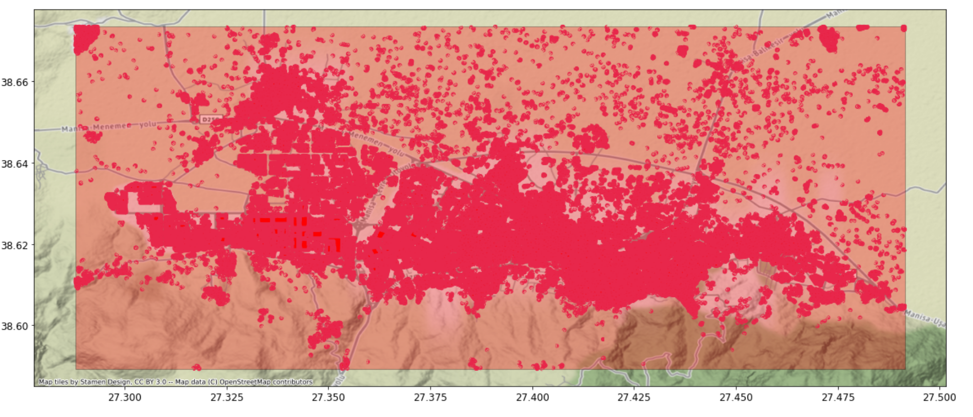
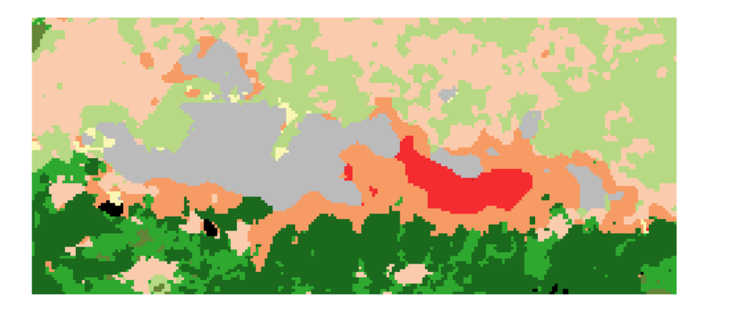
Top left:(41.02, 39.65),
Bottom right:( 40.95, 39.80)
Trabzon
Manisa
Top left:(38.67, 27.28),
Bottom right:(38.58, 27.49)

Slide 11
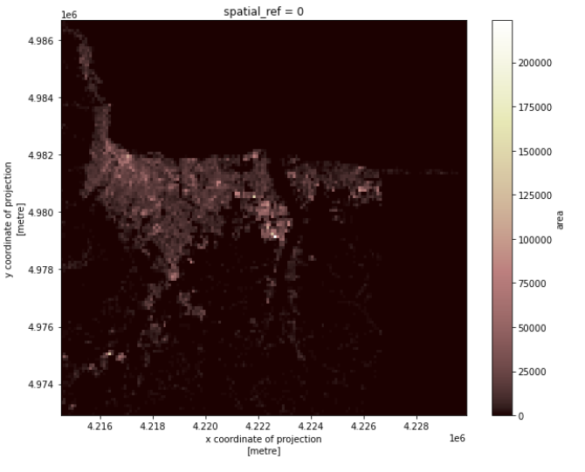
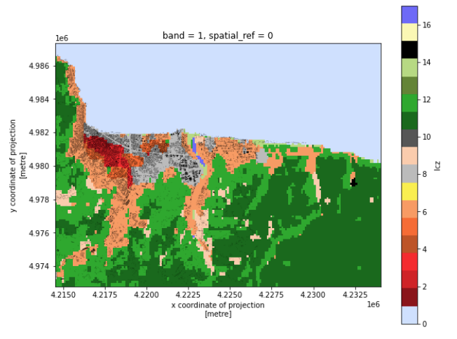
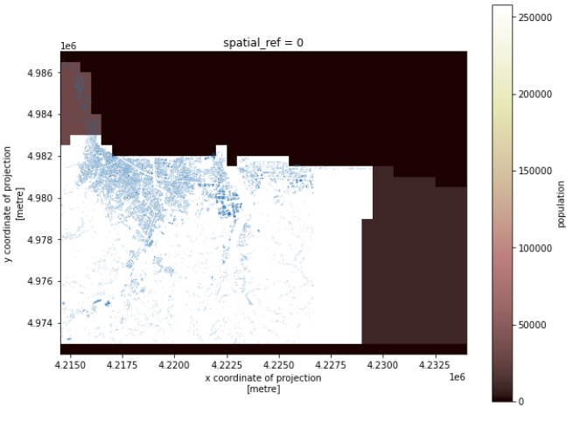
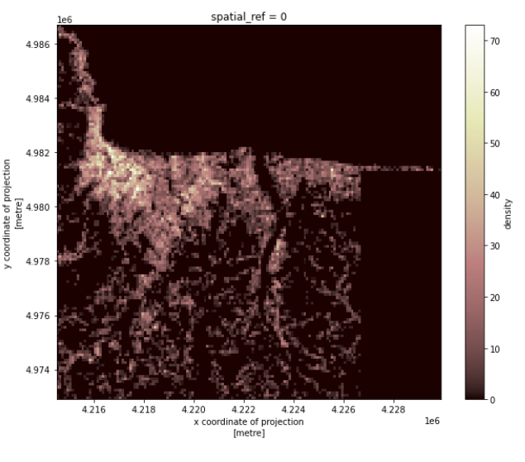
V1: gridded map with no time variance
Add polygon layers, such as administrative division, buildings, …
Add raster layers, such as LCZ, night light, …
Bind data to polygons layers, such as population, area, …
Rasterize the polygon layers (polygon -> raster)
Unify the resolution for all the raster layers
Calculate emission raster
Make output dataset and visualization
Rasterize
Polygon layers
Polygon + raster layers
Building area
Building density

Slide 12
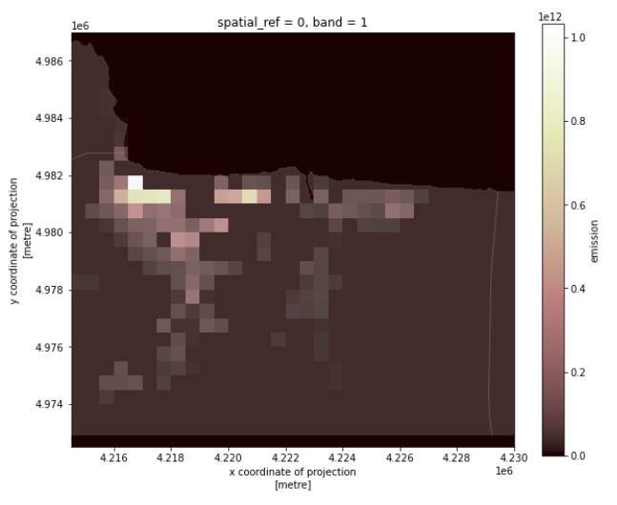
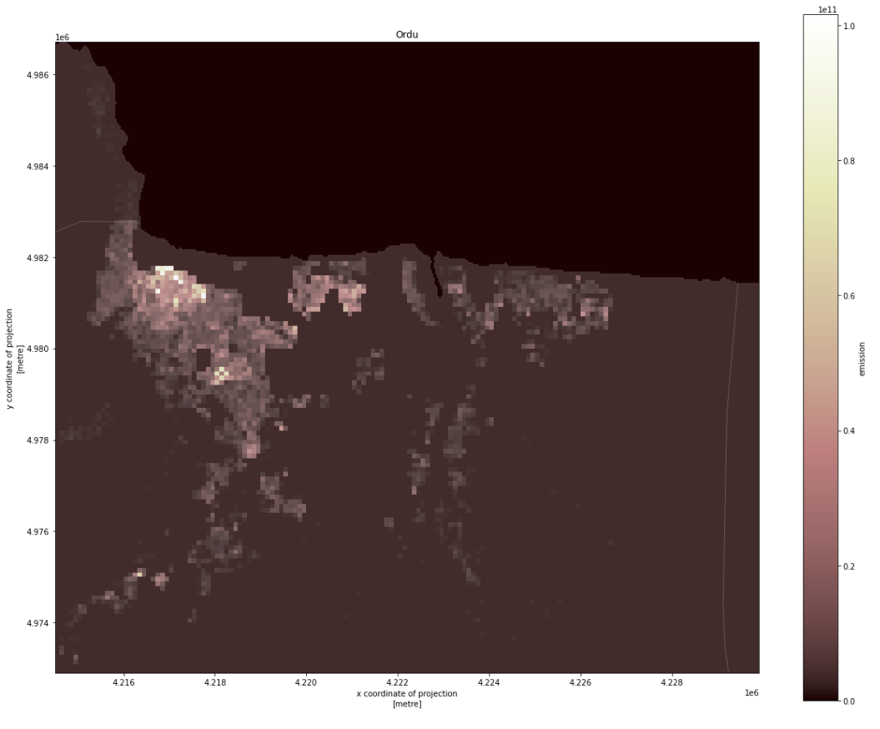
Example output for Ordu
Base resolution
500*500 m
Higher resolution is also possible
Simple emission = (density + area*lcz_height)* population

Slide 13
Timeline
clean and re-organize code and data: 2 weeks, Oct. 6th
Clean the code structure
Make the pipeline possible to plug any dataset
Add a module that predict building features
Emission map based on large-small grid: 2 weeks, Oct 20th
The emission will be firstly disaggregated with coarse but important layers, such as nightlight
The emission will be further disaggregated with fine layers inside the coarse layer grid
E_builidng = E_tot * (W_coarse * M_coarse) * (W_fine * M_fine) * M_building
E: emission
W: weight based on layer
M: modifier based on grid/building property
Final outputs: 1 week, Oct. 28th

